Slide 1


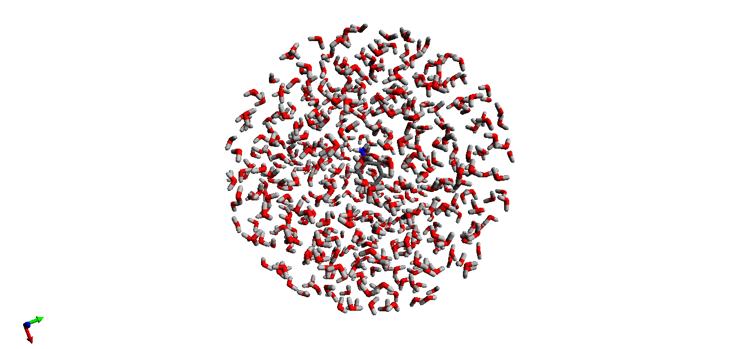

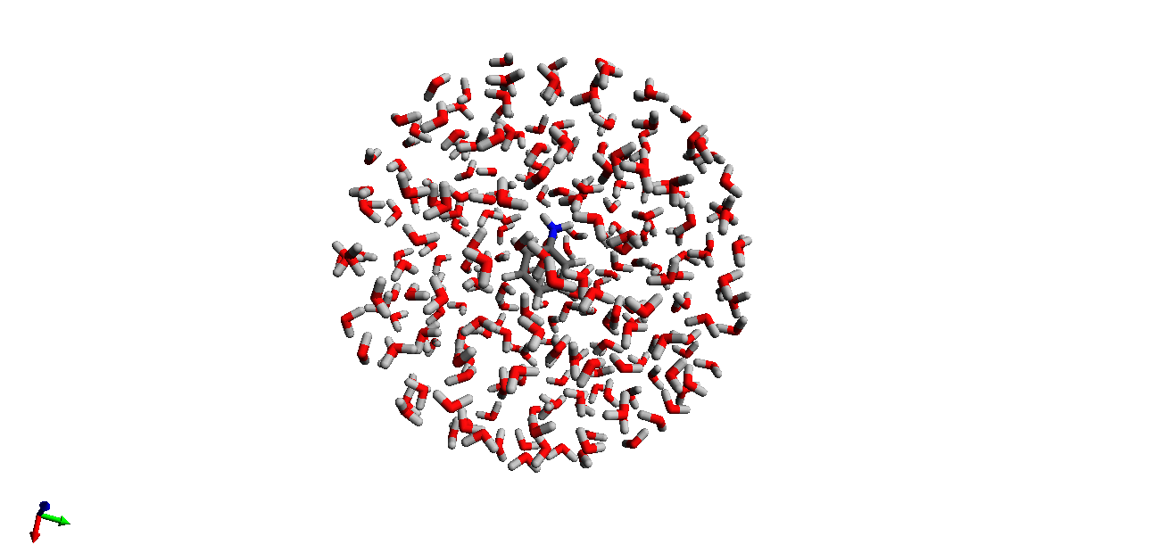
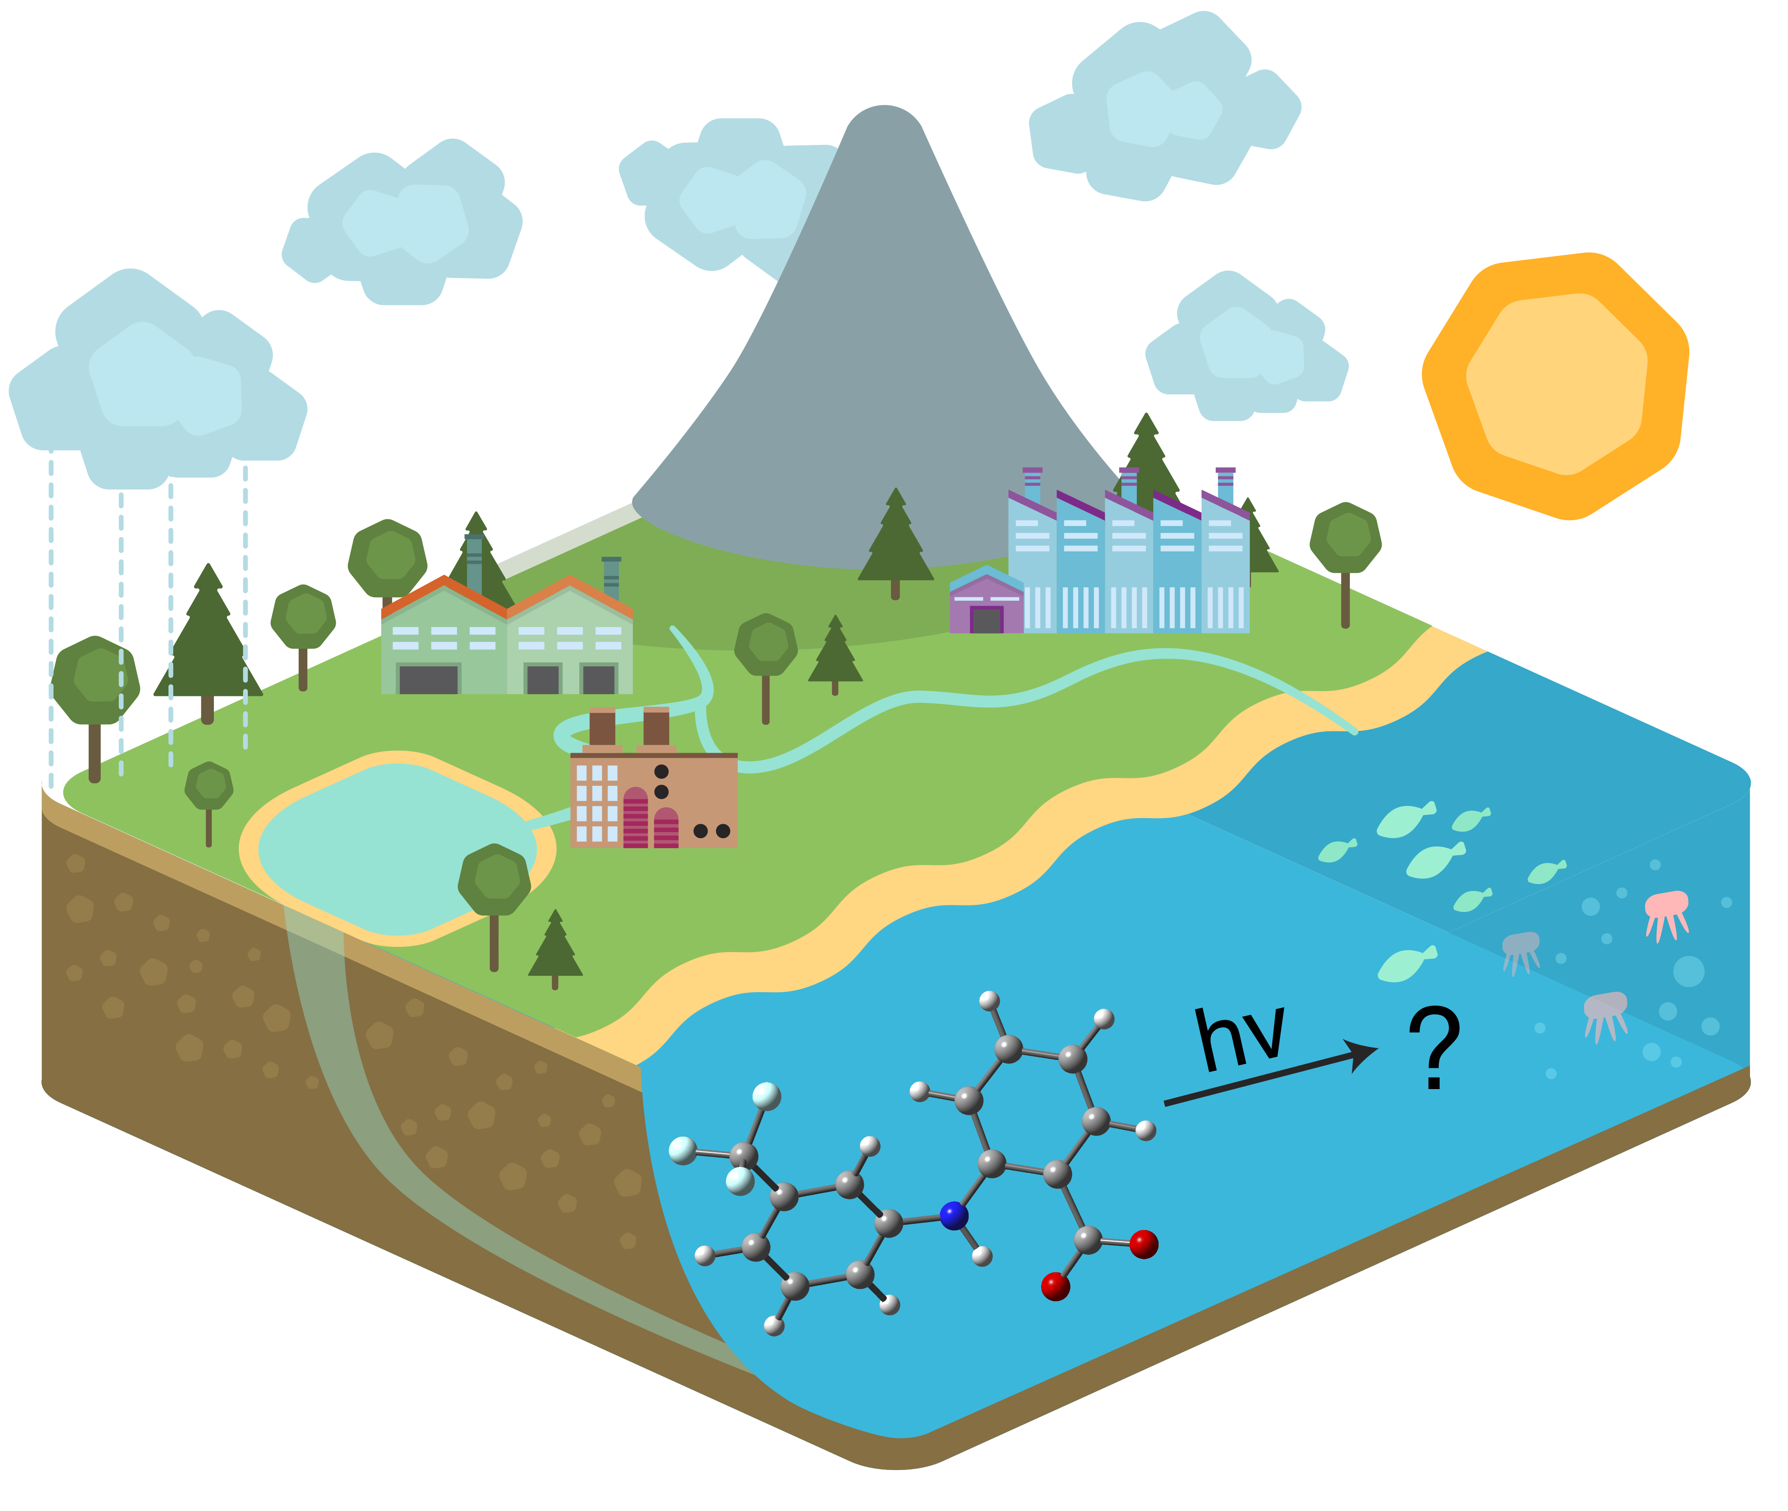
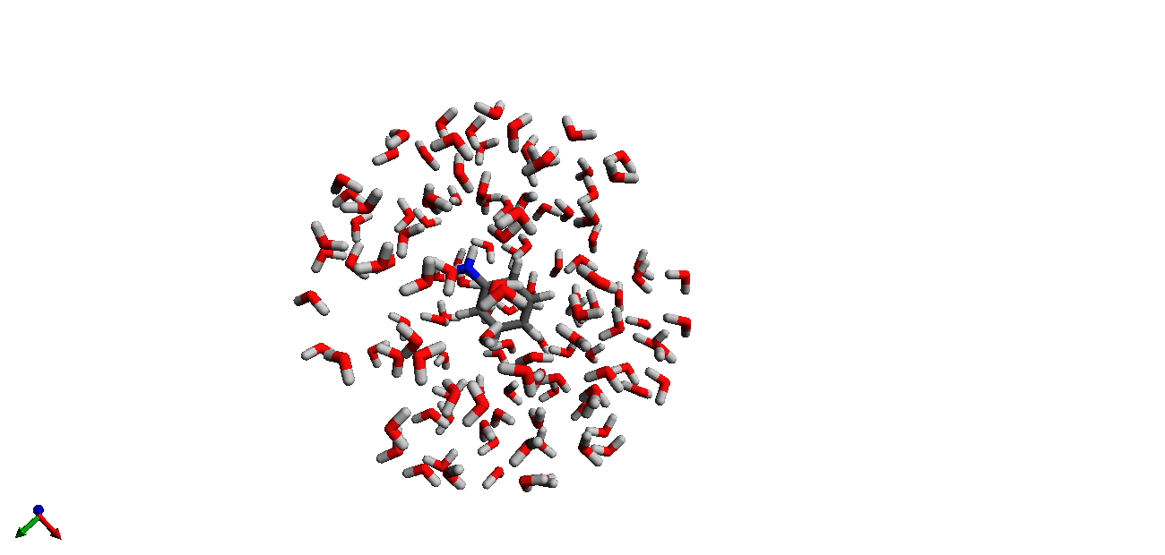
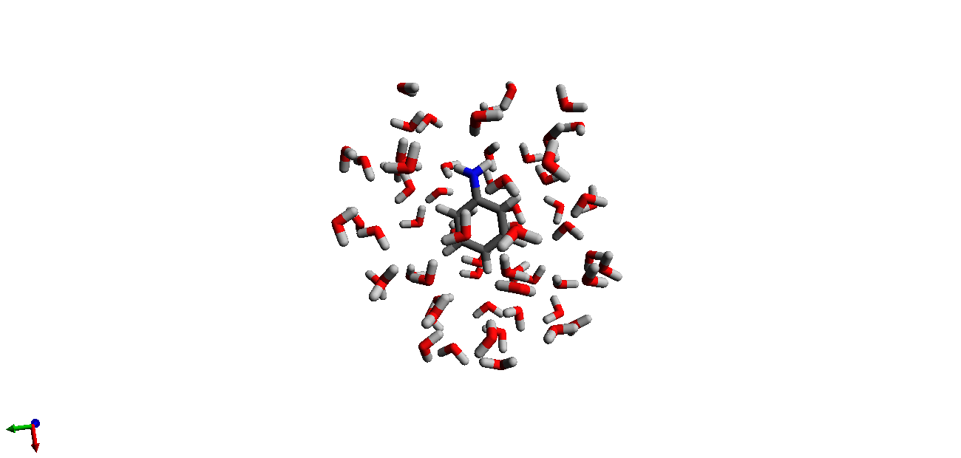
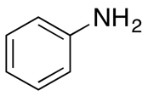
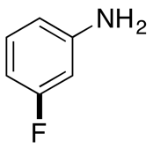
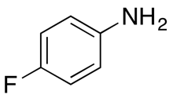
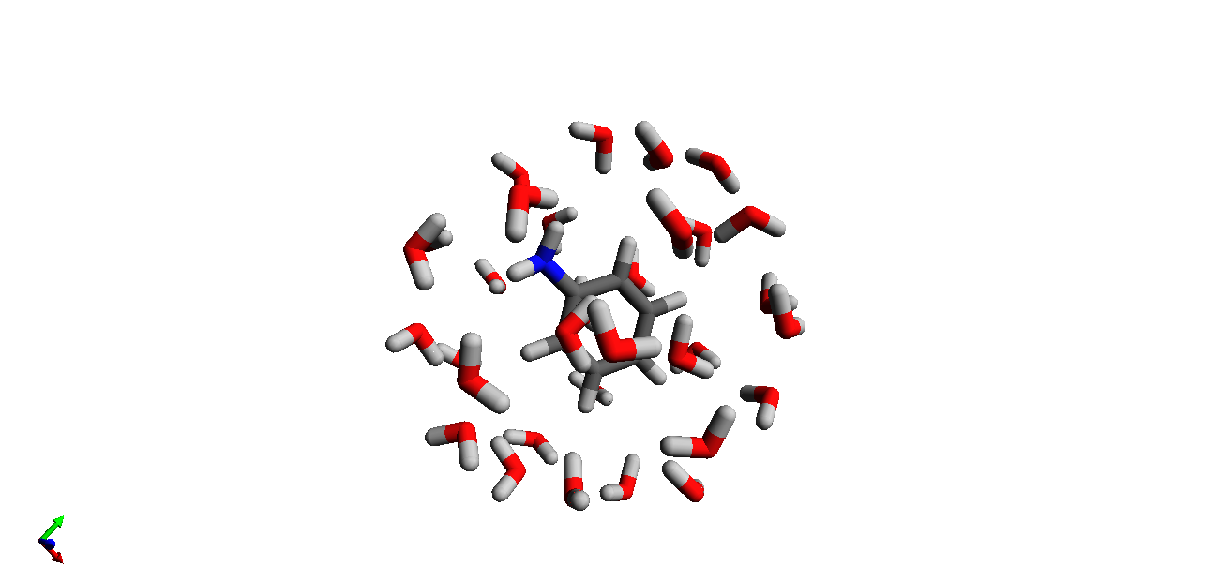
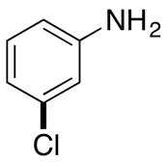
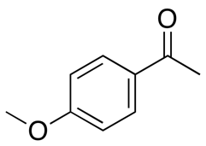
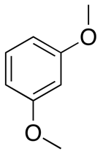
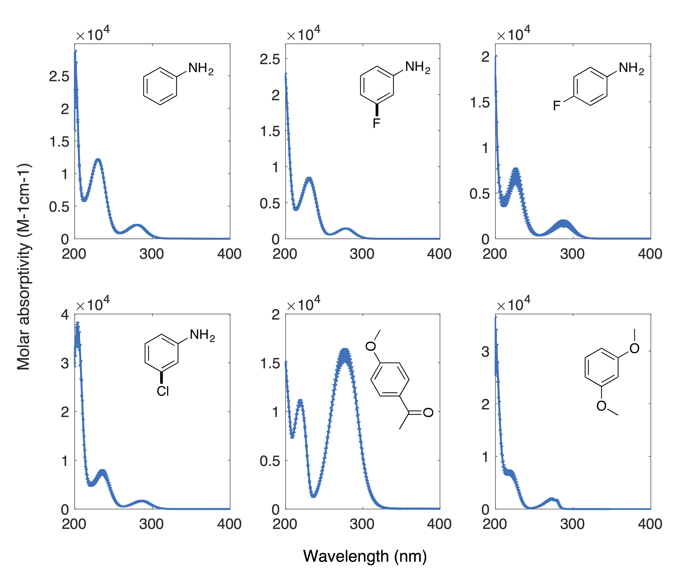
UV-Vis Molecular Absorption Spectra: Benchmarking Ab Initio Computational Methods for the Quantitative Prediction of Sunlight-Driven Pollutant Degradation in Aquatic Environments
Kasidet (Jing) Trerayapiwat and Soren N. Eustis
Department of Chemistry, Bowdoin College, Brunswick, ME 04011, USA
Motivation
Approach
Results and Discussions
Scientific understanding and public policy efforts have contributed to greatly reduce the environmental load of significant chemical pollutants, such as mercury, CCl₄ or DDT. Micropollutants, although small in quantity and safe for usage in household products, have a relatively unknown environmental fate after being disposed of into the water system. A challenge of the 21st Century is to understand the effects of micropollutants on human and environmental health¹. Micropollutants in surface waters are the result of the thousands of chemicals we use everyday finding their way into surface and groundwater. This is important because if the water is polluted, eventually animals, human, and other living beings in this world are affected. For example Triclosan in water stream undergoes photo-decomposition into dioxins and PCB, both known toxic compounds².
Difficulties of studying their environmental fate include:
Low concentration in water body
Vast variety of species of these micropollutants
The need for priori instead of posteriori study
MD-TDDFT method is chosen for it includes an explicit solvent model with an affordable cost. Parameters of the model include:
How many water molecules? - optimal for speed and accuracy
Which DFT functional to use? – for energy calculation
Results from TD-DFT vary greatly depending on the choice of DFT functionals. The electronic transitions of importance for photodegradation under sunlight can be shown by overlapping an absorption spectrum with the surface level solar radiation spectrum (fig 6). Errors in energy transition higher than 290 nm⁷ are not the main focus of this project.
Fig10. Predicted excitation energies and oscillator strength varying by equilibration time (y-axis) for aniline in 128, 256, 512-water model
Excited state energies and oscillator strengths seem to converge long before the currently expected equilibrium
Some excitation modes are combined into one because of smaller sampling size compared with the equilibrium
Advantage of using computer model:
No instrumental sensitivity
No need to separate different species of micropollutants in water
No need to introduce species in water
Understanding excitation from ground state to the singlet excited state through simulating absorption spectrum of a molecule is essential to predicting the rate of the photoreaction.
Fig9. Predicted excitation energies (x-axis) and oscillator strength (area of marker) varying by the number of water molecules using CAMB3LYP functional
32 water model fails to correlate with results from the models with more water molecules
The results start to converge beginning from 64-water to the values in 256 and 512-water model
128, 256, and 512-water models give similar results. Note that the two data points with similar values of f and λ could be the same mode of excitation separated by faulty statistical analysis
Results from CAMB3LYP in any number of water correlate poorly with the experimental results
The lowest energy transition in the 128-water model is still converging to the value of 256 and 512.
Speed for calculating MD of 512 is significantly slower than that of 256
Combined with the results from fig 10, 256-water model is chosen to apply to other molecules.
Fig1. Environmental fate of micropollutants in water. Under sunlight, molecules can undergo photo-reactions.
Accuracy
Cost
Fig7. explicit 2^{n} water model (n=5-9). The more water the more complete solvent-solute model but the slower the calculation
Fig6. electronic transition and solar radiation (ASTM G173). The transition shown in red is relevant to the study
Background
Methods
Fig11. predicted excitation state energies and oscillator strength varying by DFT functionals
BP86, though with some errors, is the best-performing functional. It calculates low energy transition that others fail to calculate especially under 290 nm which overlap with solar radiance
Dynamics of solute and solvent molecules coupling in solution led Gordon et al.⁵ to using Molecular Dynamics (MD) to obtain equilibrated geometries of solute and solvent. Solvent is modeled using Effective Fragment Potential (EFP)⁶, then Time-Dependent Density Functional Theory (TD-DFT) to calculate energies for each equilibrated geometry (see fig 3)
However no studies have been done on how many explicit water molecules are needed to achieve more accurate results or which DFT functional works best
Computational results then should be compared with experimental data collected in Eustis lab (fig 4)
Each underlying Gaussian curve represents a unique excitation mode (fig 5)
The relationship between theoretically-calculated oscillator strength (f) and experimentally-measured molar absorptivity(ε):
MD-TDDFT is performed using GAMESS¹⁰ quantum computational package. Matlab⁹ is used to deconvolute experimental spectra. All MD run use 6-311++G(2d,p) basis set calculating every 1 fs while displaying every 10 fs at bath temp = 298 K. All TD-DFT calculations use 6-31+G(d,p) basis set. Water molecules are taken into account explicitly using EFP1 and positioned initially using Packmol¹⁰. Criterion for MD equilibrium is that the average change of system’s potential energy over time crosses zero.
The flowchart for finding the best model is outlined below in fig 8. First, the optimal number of water molecules in the model is evaluated by using different numbers of water molecules surrounding aniline with CAMB3LYP functional. The results are compared with experimental data to evaluate the accuracy of the model. The most accurate model with acceptable calculation time is chosen, then applied to other molecules with different functionals before comparing again to experimental data.
Conclusion
Acknowledgement
An ideal model for calculating UV-VIS absorption spectrum has not yet been found, but an algorithm and method of study for finding it is explored. The following questions are answered:
How many water molecules? – 256 for small molecules like aniline
Which DFT functional? – currently BP86 but still left unanswered is why BP86 performs best at calculating low excited state energies
The following suggestions are made for further study:
MD-TDDFT works with molecules studied if appropriate DFT functional is used and adequate amount of water applied
More DFT functionals and molecules should be explored to achieve a more accurate model
Small well-studied micropollutants should be used to test the model as there is current evidence supporting this method
Larger molecules might require more water as the excited state energies and oscillator strengths converge with more water molecules
MD-TDDFT is a possible model to studying excitation state in small organic molecules. Before modeling absorption spectra for larger micropollutants, more sample molecules should be explored and more functionals, similar to BP86, studied.
James Stacy Coles / Littlefield Summer Research Fellowships – DCSI?
XSEDE project funded by NSF award number ACI 10-53575
Dj, Mitch Davis, Holly Rudel, Alex Poblete, Peter Cohen, Jack O’Brien
Fig3. PE plot vs time for MD
References
Schwarzenbach, R. ́ P.; Escher, B. I.; Fenner, K.; Hofstetter, T. B.; Johnson, C. A.; Gunten, U. von; Wehrli, B. The Challenge of Micropollutants in Aquatic Systems. Science (80-. ). 2006, 313 (5790), 1072–1077 DOI: 10.1126/science.1127291.
Kliegman, S.; Eustis, S. N.; Arnold, W. a; McNeill, K. Experimental and theoretical insights into the involvement of radicals in triclosan phototransformation. Environ. Sci. Technol. 2013, 47 (13), 6756–6763 DOI: 10.1021/es3041797.
Kolpin, D. W.; Meyer, M. T. Pharmaceuticals , Hormones , and Other Organic Wastewater Contaminants in U . S . Streams , 1999 - 2000 : A National Reconnaissance. Environ. Sci. Technol. 2002, 36 (6), 1202–1211 DOI: 10.1021/es011055j.
Gordon, M. S.; Freitag, M. a; Bandyopadhyay, P.; Jensen, J. H.; Kairys, V.; Stevens, W. J. The Effective Fragment Potential Method : A QM-Based MM Approach to Modeling. J. Phys. Chem. A 2001, 105 (2), 293–307 DOI: 10.1021/jp002747h.
Defusco, A.; Minezawa, N.; Slipchenko, L. V; Zahariev, F.; Gordon, M. S. Modeling Solvent Effects on Electronic Excited States. J. Phys. Chem. Lett. 2011, 2, 2184–2192 DOI: 10.1021/jz200947j.
Gordon, M. S.; Freitag, M. a; Bandyopadhyay, P.; Jensen, J. H.; Kairys, V.; Stevens, W. J. The Effective Fragment Potential Method : A QM-Based MM Approach to Modeling. J. Phys. Chem. A 2001, 105 (2), 293–307 DOI: 10.1021/jp002747h
Leifer, A. The kinetics of environmental aquatic photochemistry: theory and practice; ACS professional reference book; American Chemical Society, 1988.
General Atomic and Molecular Electronic Structure System" M.W. Schmidt; K.K. Baldridge; J.A. Boatz; S.T. Elbert; M.S. Gordon; J.H.J ensen; S. Koseki; N. Matsunaga; K.A. Nguyen; S. Su,; T.L. Windus; M. Dupuis,; J.A. Montgomery J. Comput. Chem., 14, 1347-1363(1993)..
MATLAB version 9.0 2016a,. Natick, Massachusetts: The MathWorks Inc., 2010.
Wiberg, K. B. Basis set effects on calculated geometries: 6-311++G** vs. aug-cc-pVDZ. J. Comput. Chem. 2004, 25 (11) DOI: 10.1002/jcc.20058.
L. Martínez; R. Andrade; E. G. Birgin; J. M. Martínez; Packmol: A package for building initial configurations for molecular dynamics simulations. Journal of Computational Chemistry, 30(13):2157-2164, 2009.
Fig4. experimental absorption spectra
Fig8. flowchart for finding best model
Fig5. underlying Gaussian plots

